Slide 1
Knowledge Based Systems
Dr. Thomas Njoroge, PhD

Slide 2
Problem Solving Techniques in AI
Recall, typical problem solving (and hence many AI) tasks can be commonly reduced to:
  Modeling natural phenomena, and
  Search
Techniques that model natural phenomena generally concentrate on the concept of knowledge representation
In a nutshell, some problems highlight search whilst others knowledge representation.

Slide 3
Knowledge Based Systems-Overview
Definition: a knowledge-based system is a software system capable of supporting explicit representation of knowledge and of exploiting it through appropriate reasoning mechanism in order to provide high-level problem solving performance.
Knowledge based systems are systems that use knowledge representation as their central concept.
Knowledge based systems are developed for a specific task domain

Slide 4
KBS-Overview 2
It is therefore a specific, dedicated, computer based problem solver, able to face complex problems, which if solved by man, would require advanced reasoning capabilities like:
  deduction,
  hypothetical reasoning,
  model based reasoning,
  analogical reasoning,
  learning etc.
Knowledge based systems are developed for a specific task domain.

Slide 5
KBS-Tasks
Typical tasks for which knowledge based systems can be built include:
  Diagnosis
  Scheduling
  Design
  Planning
  Configuration

Slide 6
What is Knowledge?
Knowledge is a theoretical or practical understanding of a subject or a domain. Knowledge is also the sum of what is currently known, and apparently knowledge is power.
Those who possess knowledge are called experts.
Anyone can be considered a domain expert if he or she has deep knowledge (of both facts and rules) and strong practical experience in a particular domain. The area of the domain may be limited.
In general, an expert is a skilful person who can do things other people cannot.

Slide 7
Classification of Knowledge-Criteria 1
Priori Knowledge
  Universally true and cannot be denied without contradiction e.g. mathematical laws, logical statements.
Posteriori Knowledge
  Represents knowledge that is verified using sensory experiences. Such knowledge can be denied based on new knowledge without the need for contradictions.
  E.g. “”

Slide 8
Classification of Knowledge-Criteria 2
Procedural (Compiled) Knowledge
  Considers the manner in which things work under different sets of circumstances. Includes step-by-step sequences and how-to types of instructions; it may also include explanations.
Declarative Knowledge
  Descriptive representation of knowledge. It tells us facts: what things are e.g. “Elizabeth Kiiru is a young Kenyan woman”.
Tacit Knowledge
  Unconsciously knowing how to do something. By definition, tacit knowledge is not easily shared.
  Tacit knowledge consists often of habits and culture that we do not recognize in ourselves. The concept of tacit knowledge refers to a knowledge which is only known to you and hard to share with someone else, which is the opposite from the concept of explicit knowledge.
Meta Knowledge
  Knowledge about knowledge.

Slide 9
CONCEPTUAL STRUCTURE OF A KBS (CONCEPTUAL SCHEMA)
A knowledge-based system is generally composed of two parts:
Central Part (Kernel)
  This implements the basic problem solving capabilities of the knowledge-based system.
  The kernel is in turn composed of three main components:
    Knowledge base (KB)
    Reasoning mechanism-inference engine.
    Working memory
Peripheral Part
  This provides additional functions necessary for a practical and effective use of the knowledge based system e.g. user interface, explanation system, learner, knowledge acquisition facility, etc.

Slide 10
Diagram-Conceptual Schema
Domain
Knowledge
Knowledge Base
Reasoning
Mechanism
Problem
Working Memory
Knowledge Based
System
Solution

Slide 11
Components of A Knowledge Based System
Based on the conceptual scheme above, a typical knowledge based system has the following components.
  A knowledge base
  An inference engine
  A user interface
  Explanation facilities
  Learning facilities

Slide 12
Components-2
The knowledge base contains the domain knowledge useful for problem solving. In a rule-based expert system, the knowledge is represented as a set of rules. Each rule specifies a relation, recommendation, directive, strategy or heuristic and has the IF (condition) THEN (action) structure. When the condition part of a rule is satisfied, the rule is said to fire and the action part is executed.
The database/working memory includes a set of facts used to match against the IF (condition) parts of rules stored in the knowledge base.

Slide 13
Components-3
The inference engine carries out the reasoning whereby the KBS reaches a solution. It links the rules given in the knowledge base with the facts provided in the database.
The explanation facilities enable the user to ask the KBS how a particular conclusion is reached and why a specific fact is needed. A KBS (specifically an expert system) must be able to explain its reasoning and justify its advice, analysis or conclusion.
The user interface is the means of communication between a user seeking a solution to the problem and a KBS.

Slide 14
Diagram Depicting components of KBS
Inference Engine
Explanation Facility
Knowledge
base
Knowledge
acquisition
facility
User
interface
Experts
User

Slide 15
Criteria for choosing to implement a KBS
Only certain types of applications are suited to knowledge based implementation. The following criterion is used in identifying suitable domains. The fields under study:
  Should be able to be reduced to a series of rules rather then mathematical formulae or equations. – Knowledge based systems not applicable if domain has a large number of complex calculations.
  Is well understood so that well-defined knowledge can be formulated and represented in Computer for a
  Should not encompass problems which take too short (i.e. less than half an hour) or too long (larger than say one week) a time to solve.
  Should have general agreement among recognized experts in the domain to be computerized.
  The knowledge within the problem domain should be sufficiently large to warrant the development of a knowledge-based system.
  ‘Tame’ experts who are agreeable to involvement.
However, any application that requires access to specialist knowledge is a potential area for knowledge based systems technology.

Slide 16
Characteristics of a KBSs
high-quality performance.
No matter how fast the system can solve a problem, the user will not be satisfied if the result is wrong!
On the other hand, the speed of reaching a solution is very important. Even the most accurate decision or diagnosis may not be useful if it is too late to apply, for instance, in an emergency, when a patient dies or a nuclear power plant explodes.

Slide 17
Characteristics of a KBS-2
KBSs apply heuristics to guide the reasoning and thus reduce the search area for a solution.
A unique feature of a KBS is its explanation capability. It enables the system to review its own reasoning and explain its decisions.
KBSs employ symbolic reasoning when solving a problem. Symbols are used to represent different types of knowledge such as facts, concepts and rules.

Slide 18
Characteristics of a KBS-3
We should be aware that an expert is only a human and thus can make mistakes, and therefore, a KBS built to perform at a human expert level also should be "allowed" to make mistakes.
In KBSs, knowledge is separated from its processing (knowledge base and inference engine are split up). A conventional program is a mixture of knowledge and the control structure to process this knowledge.
When an expert system shell is used, a knowledge engineer or an expert simply enters rules in the knowledge base. Each new rule adds some new knowledge and makes the KBS smarter.

Slide 19
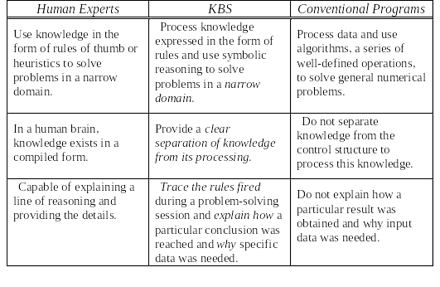
KBS Comparison

Slide 20
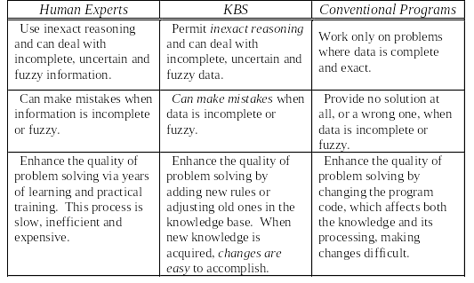
KBS Comparison-2

Slide 21
KNOWLEDGE ENGINEERING
This refers to the process of developing knowledge-based systems.
Practitioners of Knowledge Engineering are called Knowledge Engineers.
Thus the development of a Knowledge based system should follow a professional approach with respect to:
  qualifications,
  personality, and
  attributes.

Slide 22
Process of Knowledge Engineering
Consists of five activities:
  Knowledge acquisition
  Knowledge Validation
  Knowledge Representation
  Inferencing and
  Explanation.

Slide 23
TASKS OF KNOWLEDGE ENGINEERS
Extracting knowledge from people. (KA)
Representing knowledge in some form. (KR)
Including knowledge in a computer program which makes use of the knowledge.
Validating the software system produced.

Slide 24
TYPES OF KNOWLEDGE BASED SYSTEMS
In general, knowledge based systems are classified according to the human behavior they attempt to mimic. On the basis of this, we have:
Expert Systems
  They model the higher order cognitive functions of the human mind
  They are used to mimic the decision making process of the human mind.
Neural Networks
  They model the brain at the biological level
  They are adept at pattern recognition and introduce the concept of learning into computing.
Case Based Reasoning
  Models the human ability to learn from past experience
  They borrow from the legal system where past cases are used as a basis for making decisions in the present cases.
Fuzzy Logic systems
  Provide mechanisms for handling uncertain knowledge

Slide 25
Q & A

